Slide 1
Orlando eKhaya & Cottesloe Project
2023
Prospectus

Slide 2
RFP 28/2023 FY/JPC – REQUEST FOR PROPOSALS FOR THE DEVELOPMENT AND LONG TERM LEASE OF ERF 13 ORLANDO EKHAYA RFP 29/2023 FY/JPC – REQUEST FOR PROPOSALS FOR THE DEVELOPMENT AND LONG TERM LEASE OF ERF 14 ORLANDO EKHAYA RFP 30/2023 FY/JPC – REQUEST FOR PROPOSALS FOR THE DEVELOPMENT AND LONG TERM LEASE OF ERF 15 ORLANDO EKHAYA RFP 31/2023 FY/JPC – REQUEST FOR PROPOSALS FOR THE DEVELOPMENT AND LONG TERM LEASE OF ERF 16 ORLANDO EKHAYA RFP/32/2023 FY/JPC - REQUEST FOR PROPOSALS FOR THE DEVELOPMENT AND LONG TERM LEASE ERVEN 159,161,162,163,164,165,166,167,168,169 AND ERF 530 COTTESLOE DOCUMENT AVAILABLE FROM: 02 JUNE 2023 CLOSING DATE: 07 JULY 2023 NON-COMPULSORY BRIEFING SESSION – 21 JUNE 2023

Slide 3
ORLANDO eKHAYA BACKGROUND
Orlando eKhaya is 56ha mixed use development precinct located at the eastern gateway to Soweto.
The Orlando eKhaya Precinct seeks to grow as a regional destination for retail, recreation, tourism and investment.
Services such as shopping facilities, public transport, banks, filling stations, police stations, medical facilities, Educational Facilities and all applicable amenities are within the immediate and surrounding areas.
Planned to be developed as a number of separate but interrelated development sites

Slide 4
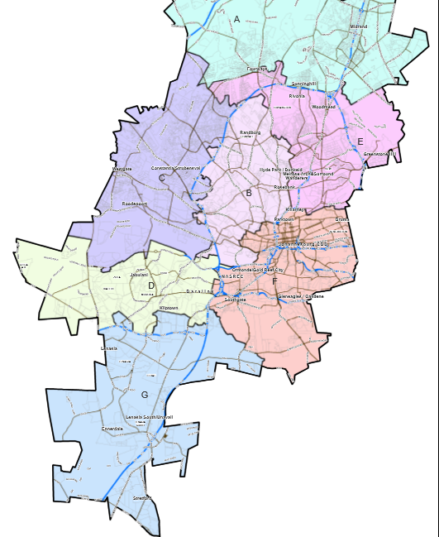
ORLANDO EKHAYA OBJECTIVES:
:
The vision is to transform Soweto into a liveable city district in its own right with access to jobs and an array of urban amenities, economic opportunities and social services.
To accommodate the mix land uses by taking advantage of the Precinct’s location in terms of the Baralink Node.
Since this development is centred around the Orlando Dam and the Orlando Towers which are a colourful attraction and a popular spot for a range of adventures activities. The successful developer should take advantage of these icons as well as the location in terms of sports and recreational activities (canoeing, artisanal food markets offering traditional cuisine, picnicking, bungee and base jumping, quad biking wall climbing, paint balling, zip lining etc)
To accommodate medium to high density mixed income residential, student accommodation, retail, community facilities, recreation and public spaces within a well balanced and sustainable urban structure, well connected and accessible to the precincts within and the greater Soweto Region – a place to LIVE, WORK and PLAY.
To create a destination place for the local community, one the City can be proud of

Slide 5
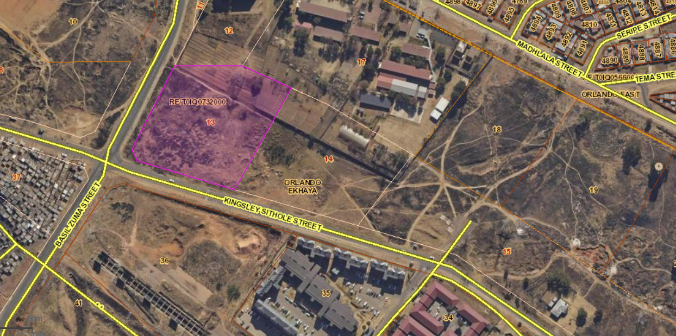
Aerial map: ERF 13 ORLANDO EKHAYA

Slide 6
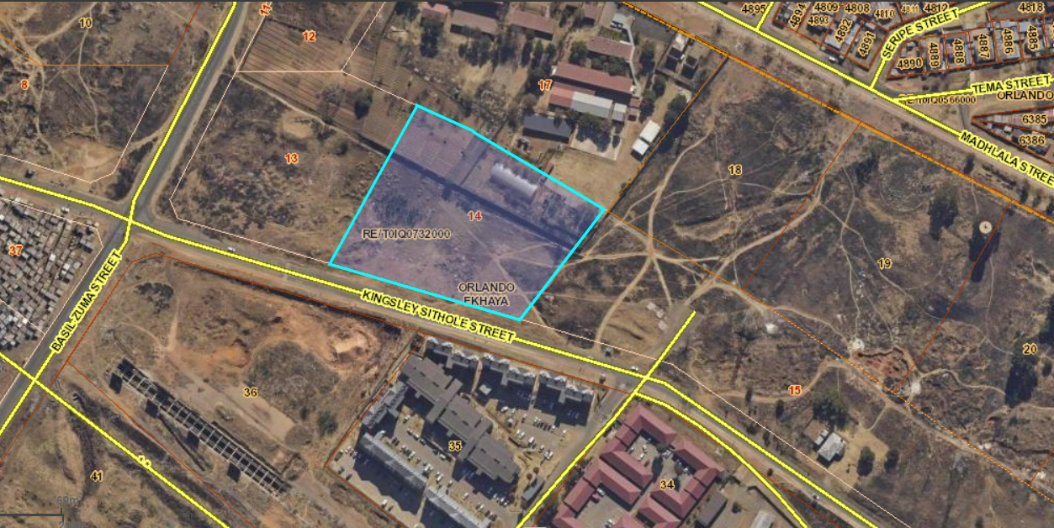
Aerial map: ERF 14 ORLANDO EKHAYA

Slide 7
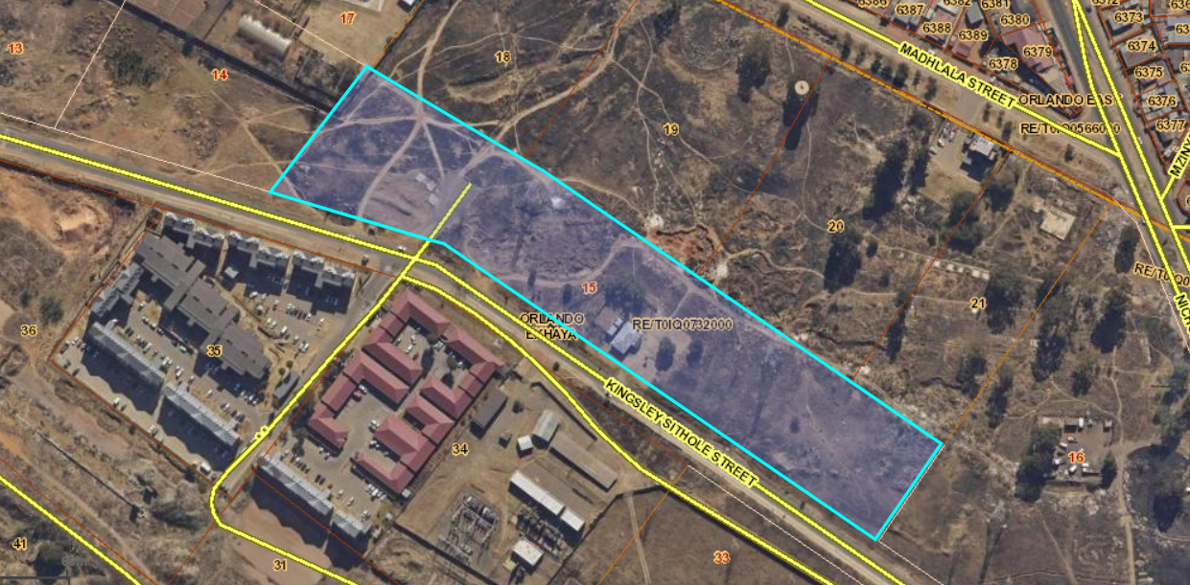
Aerial map: ERF 15 ORLANDO EKHAYA

Slide 8
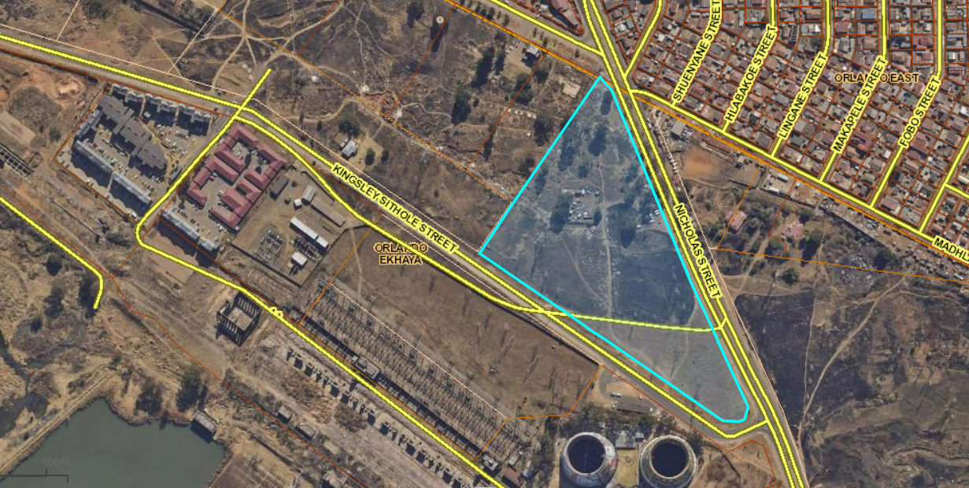
Aerial map: ERF 16 ORLANDO EKHAYA

Slide 9
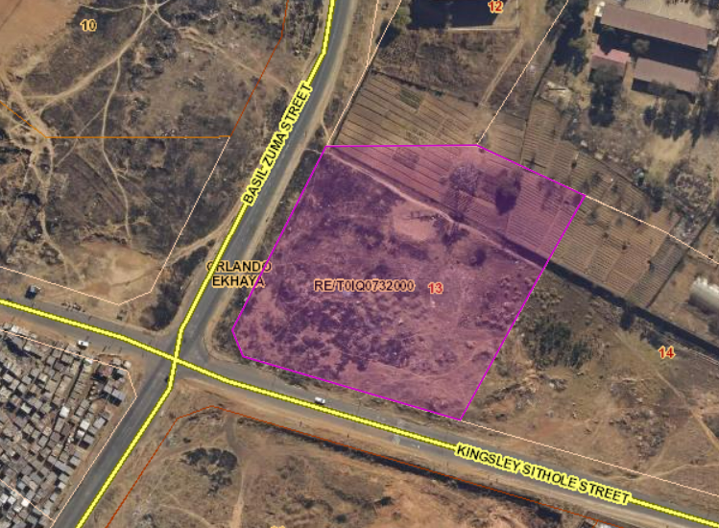
ERF 13 ORLANDO EKHAYA
LOCATION | The site is located on Basil Road, along Chris Hani Drive between the Baralink Node in the east and the Klipspruit Valley with Maponya Mall and the Nancefield Precinct to the west. The suburb Orlando East borders the Precinct in the north and Pimville with the University of Johannesburg (UJ) Soweto campus form the southern boundaries. Region D. The subject property is vacant land that forms part of Orlando Ekhaya Urban Development framework.
EXTENT ZONING | Total Size 12,369 m² Electrical Servitude of approximately 3 069 m² Net Land Area 9,300 m² Business 1
DEVELOPMENT OBJECTIVES | Mixed use, with emphasis on Student Accommodation accommodating a mix of land uses that will support surrounding uses and activities. The property shall be developed into mixed use development with special emphasis on student accommodation with a minimum of 50% of the total development being earmarked for affordable Student Accommodation at a maximum rental of R 4 500.00 per unit per month. The allocation of these affordable units (50%) will be in line with the COJ policies. A well- balanced and sustainable urban structure that is connected and accessible to the residents of Soweto and the City.
DEVELOPMENT YIELDS | Other uses include businesses, commercial, retail, and institutional and recreational facilities.

Slide 10
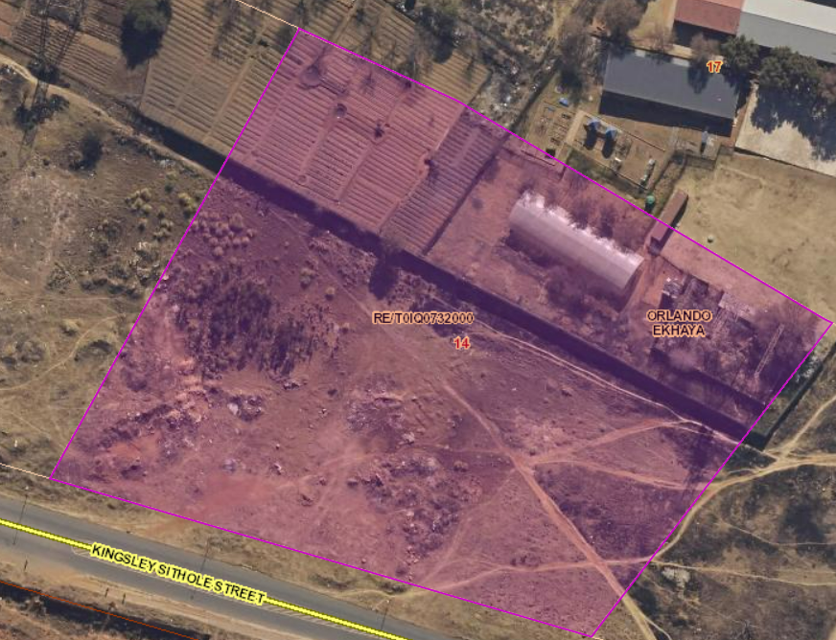
ERF 14 ORLANDO EKHAYA
LOCATION | The site is located on Basil Road, along Chris Hani Drive between the Baralink Node in the east and the Klipspruit Valley with Maponya Mall and the Nancefield Precinct to the west. The suburb Orlando East borders the Precinct in the north and Pimville with the University of Johannesburg (UJ) Soweto campus form the southern boundaries. Region D. The subject property is vacant land that forms part of Orlando Ekhaya Urban Development framework.
EXTENT ZONING | Total Size 13,139 m² Electrical Servitude of approximately 3 069 m² Net Land Area 10,070 m² Business 1
DEVELOPMENT OBJECTIVES | Mixed use, with emphasis on Student Accommodation accommodating a mix of land uses that will support surrounding uses and activities. The property shall be developed into mixed use development with special emphasis on Student Accommodation with a minimum of 50% of the total development being earmarked for affordable Student Accommodation at a maximum rental of R4 500.00 per unit per month. The allocation of these affordable units (50%) will be in line with the COJ policies. A well- balanced and sustainable urban structure that is connected and accessible to the residents of Soweto and the City.
DEVELOPMENT YIELDS | Other uses include businesses, commercial, retail, and institutional and recreational facilities.

Slide 11
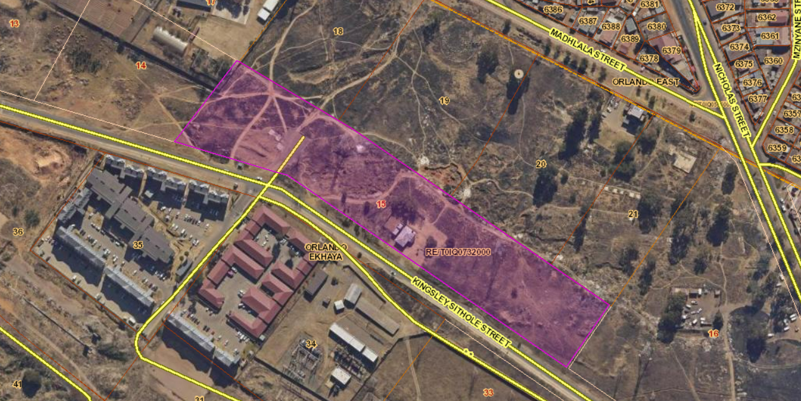
ERF 15 ORLANDO EKHAYA
LOCATION | The site is located on Basil Road, along Chris Hani Drive between the Baralink Node in the east and the Klipspruit Valley with Maponya Mall and the Nancefield Precinct to the west. The suburb Orlando East borders the Precinct in the north and Pimville with the University of Johannesburg (UJ) Soweto campus form the southern boundaries. Region D. The subject property is vacant land that forms part of Orlando Ekhaya Urban Development framework.
EXTENT ZONING | Total Size 25,415 m² Electrical Servitude of approximately 3 069 m² Net Land Area 22,346 m² Business 1
DEVELOPMENT OBJECTIVES | Mixed use, with emphasis on Affordable Housing with a mix of land uses that will support surrounding uses and activities. The property shall be developed into mixed use development with special emphasis on mixed rental residential with a minimum of 50% of the total development being earmarked for Affordable Housing at a maximum rental of R 1 500 per unit per month excluding municipal services. The allocation of these affordable units (50%) will be in line with the COJ policies targeted for low income earners who earn less that R4 500. A well- balanced and sustainable urban structure that is connected and accessible to the residents of Soweto and the City.
DEVELOPMENT YIELDS | Other uses include businesses, commercial, retail, and institutional and recreational facilities. .

Slide 12
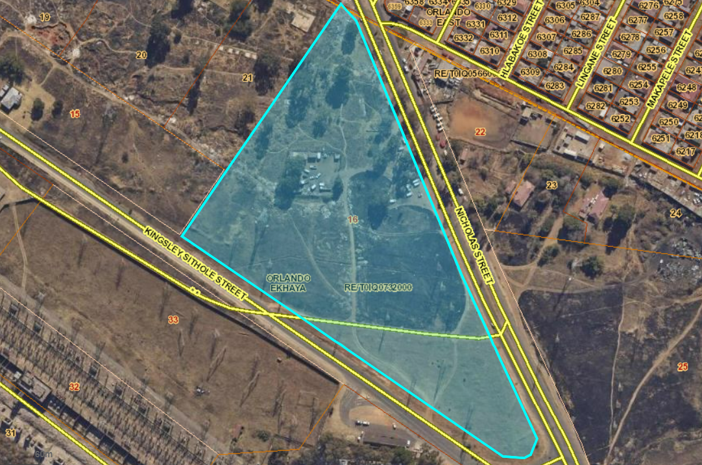
ERF 16 ORLANDO EKHAYA
LOCATION | The site is located on Basil Road, along Chris Hani Drive between the Baralink Node in the east and the Klipspruit Valley with Maponya Mall and the Nancefield Precinct to the west. The suburb Orlando East borders the Precinct in the north and Pimville with the University of Johannesburg (UJ) Soweto campus form the southern boundaries. Region D. The subject property is vacant land that forms part of Orlando Ekhaya Urban Development framework.
EXTENT ZONING | Total Size 43, 332 m² Electrical Servitude of approximately 3 069 m² Net Land Area 40,263 000 m² Business 1
DEVELOPMENT OBJECTIVES | Mixed use, with emphasis on Affordable Housing with a mix of land uses that will support surrounding uses and activities. The property shall be developed into mixed use development with special emphasis on mixed rental residential with a minimum of 50% of the total development being earmarked for affordable housing at a maximum rental of R 1 500 per unit per month excluding municipal services. The allocation of these affordable units (50%) will be in line with the COJ policies targeted for low income earners who earn less that R4 500. A well- balanced and sustainable urban structure that is connected and accessible to the residents of Soweto and the City.
DEVELOPMENT YIELDS | Other uses include businesses, commercial, retail, and institutional and recreational facilities.

Slide 13
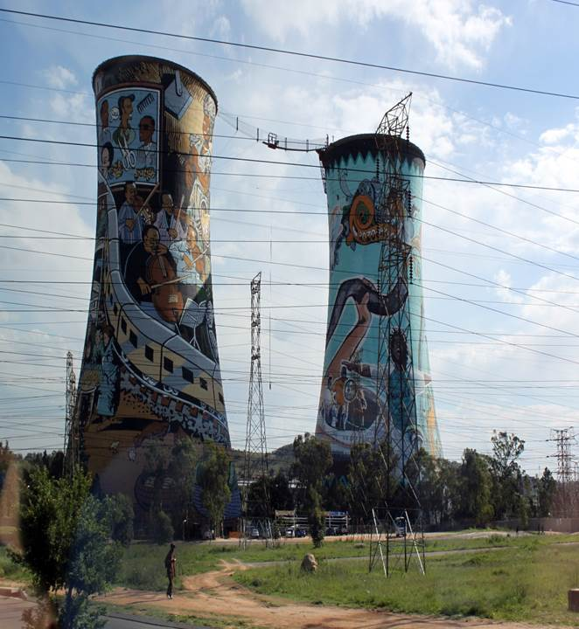
ORLANDO EKHAYA servitudes
 | There is a power line servitude in favour of Eskom with ancillary rights as will more fully appear from Notarial Deed K2411/1999S registered on 21 May 1999 (SG 5225/1996). There is a 3m wide sewer line unregistered servitude that runs along the power line servitude on all the sites.
Servitudes affecting Erven 13, 14, 15, and 16 Orlando Ekhaya

Slide 14
Land use scheme of 2018 Orlando ekhaya
The primary land use rights as per CoJ land use scheme accommodates the following uses:
Residential
Student Accommodation
Businesses
Commercial
Retail
Training Facilities
Recreational Facilities

Slide 15
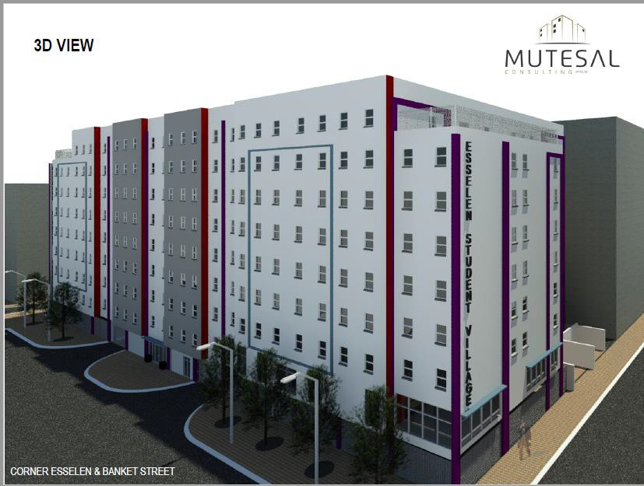
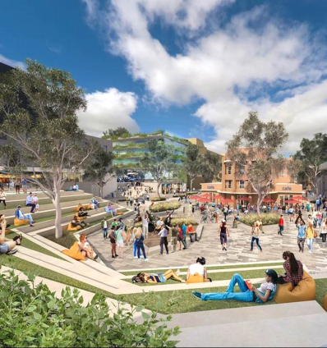
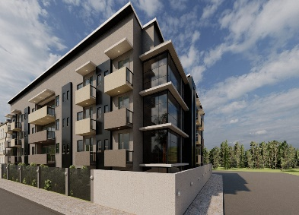
Possible Look and feel – some images

Slide 16
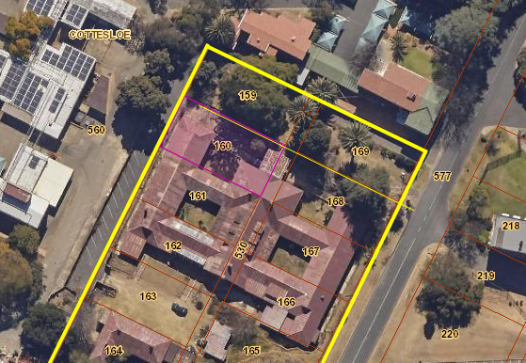
Aerial map: ERVEN 159,161,162,163,164,165,166,167,168,169 AND ERF 530 COTTESLOE

Slide 17
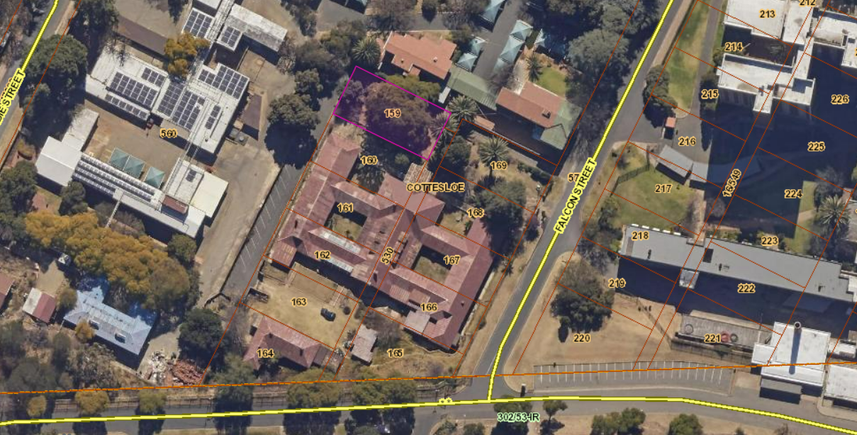
ERVEN 159,161,162,163,164,165,166,167,168,169 AND ERF 530 COTTESLOE
LOCATION | The site is located in the University of Johannesburg Precinct formerly known as Cransley House situated at NO: 9 Falcon Street Cottesloe Suburb.
EXTENT ZONING | Total Size 5 903 m² Institutional
DEVELOPMENT OBJECTIVES | Redevelopment for Student Accommodation accommodating. The property shall be developed into Student Accommodation with a minimum of 30% of the total development being earmarked for affordable Student Accommodation at a maximum rental of R4 500.00 per unit per month. The allocation of these affordable units (30%) will be in line with the COJ policies. A well- balanced and sustainable urban structure that is connected and accessible to the University of Johannesburg Educational precinct.

Slide 18
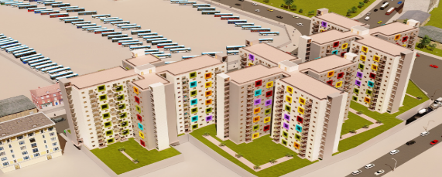
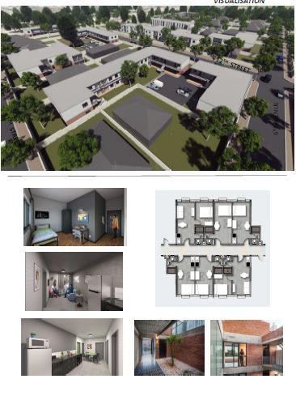
Possible Look and feel – some images

