Slide 1
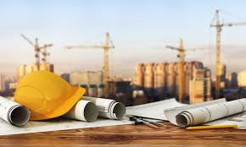
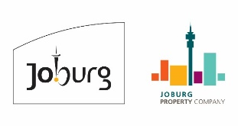
Turning the Inner City into a Construction site

Slide 2
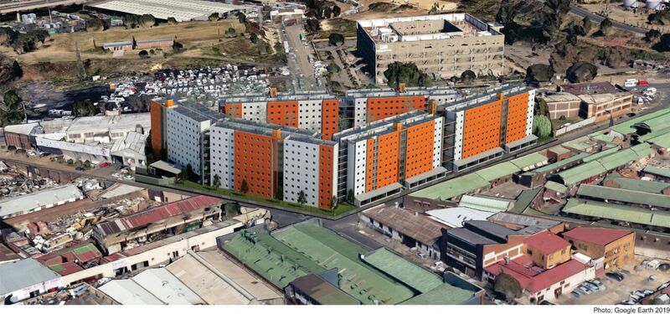
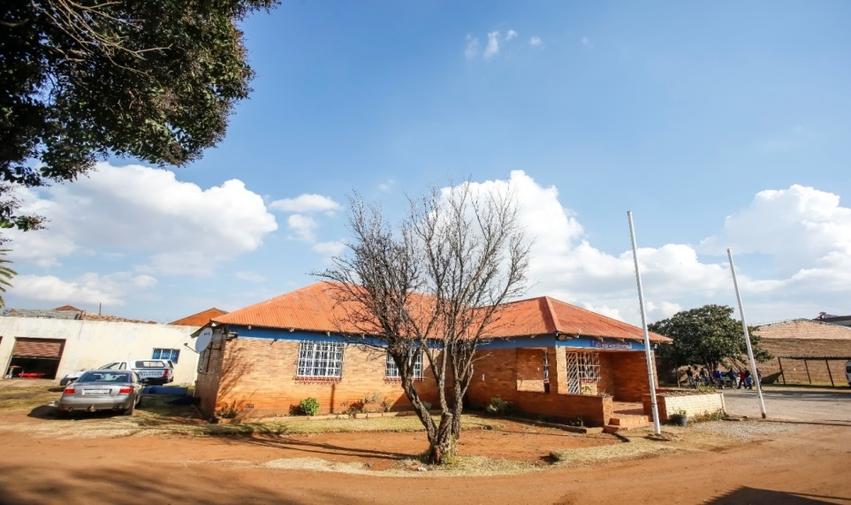
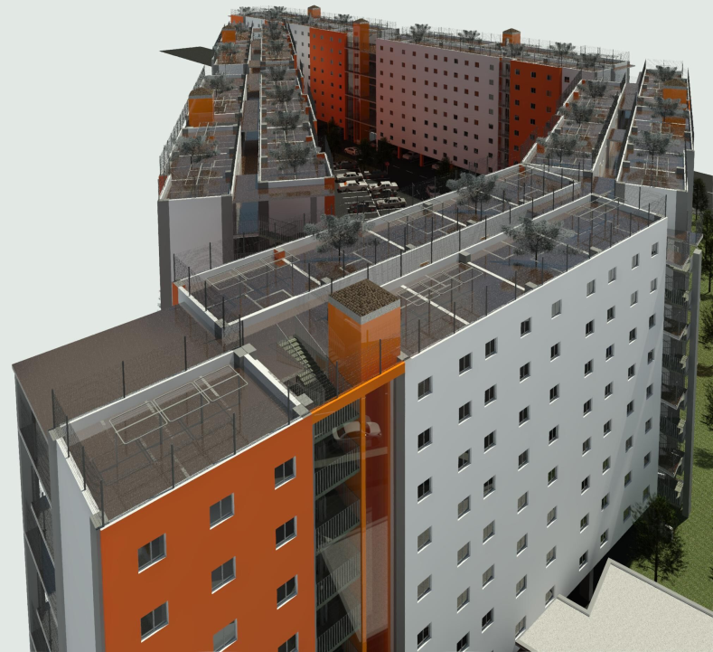
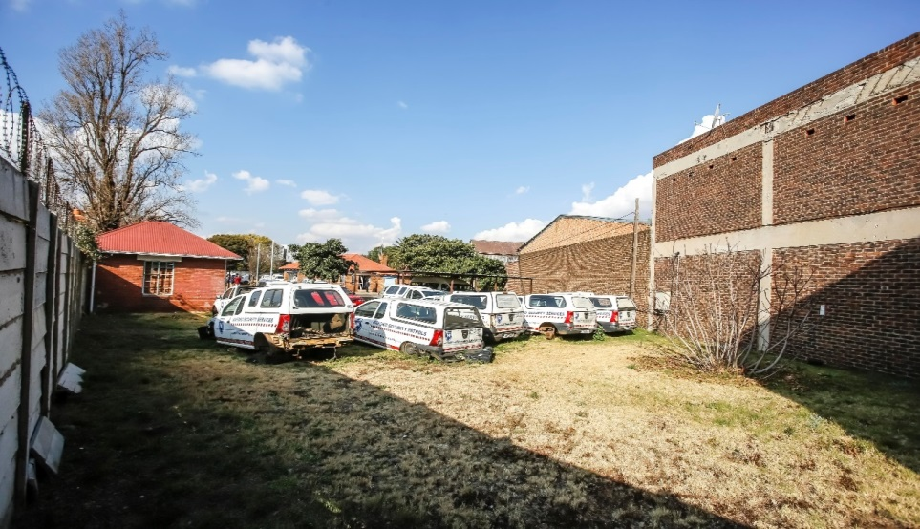
REMAINDER OF ERF 1015 CITY AND SUBURBAN (RFP 32/2018)
After
Before

Slide 3
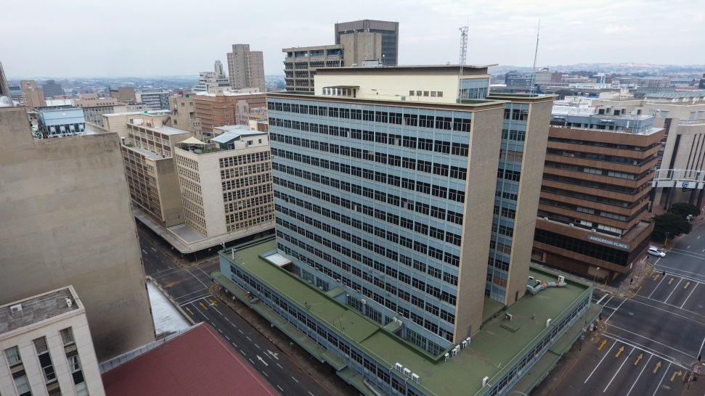
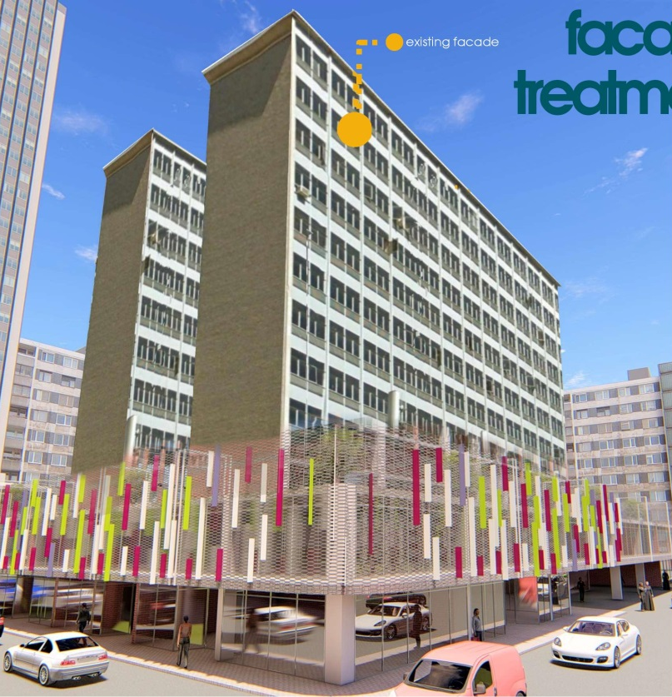
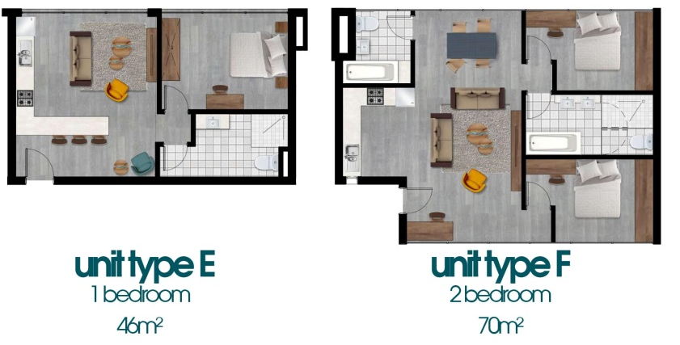
ERVEN 171 – 178 MARSHALLS TOWN (RFP 30/2018)
Before
After

Slide 4
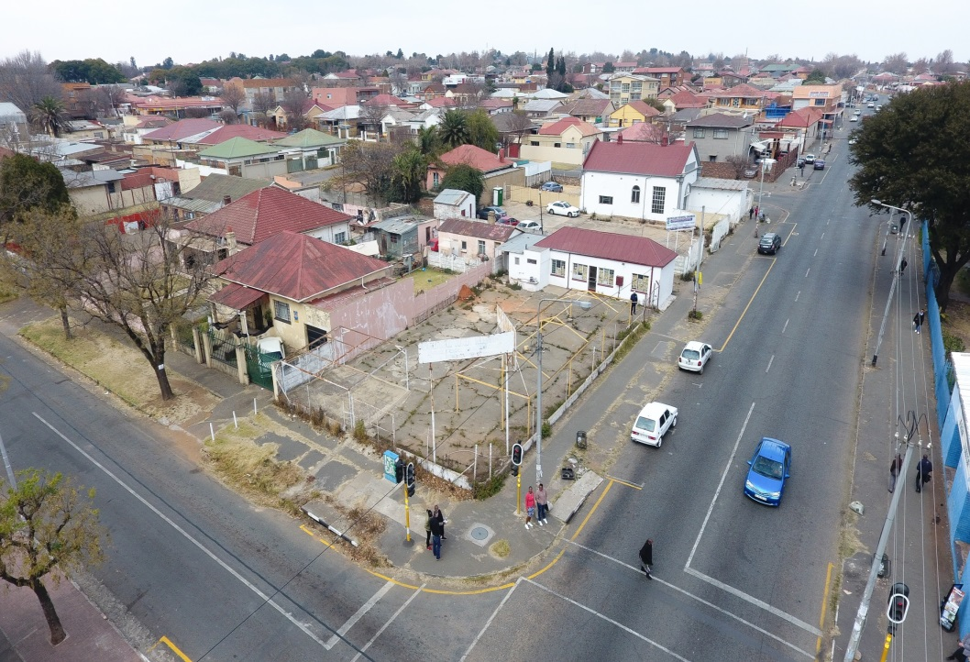
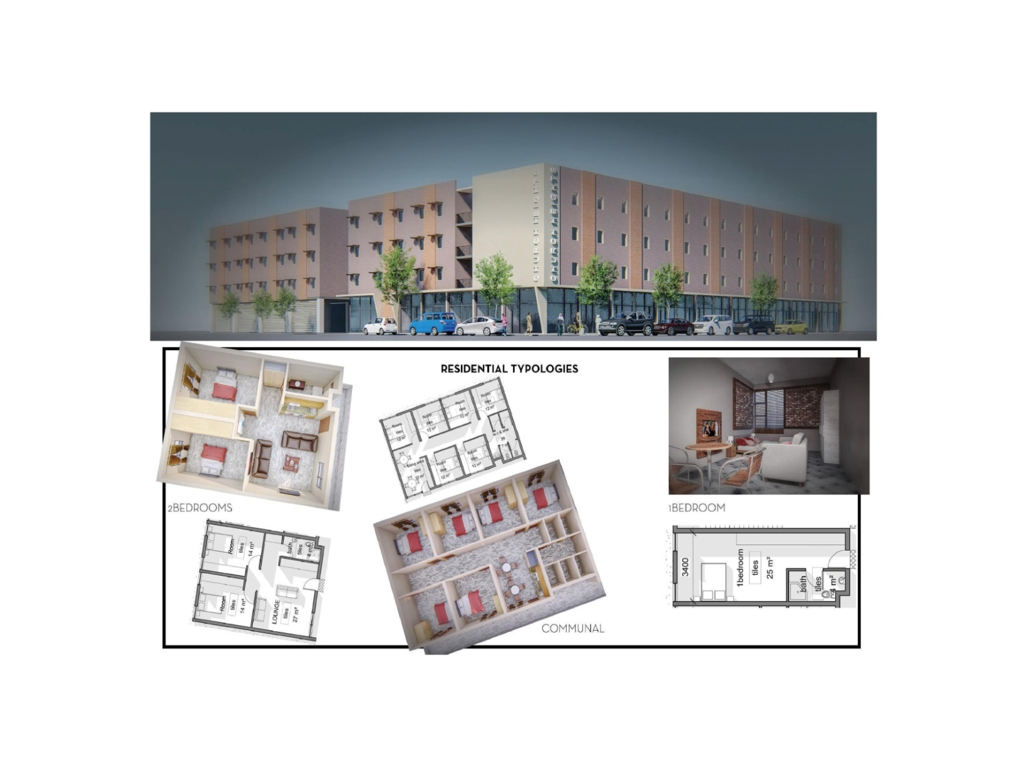
ERVEN 1633, 1637, 1638, 1639 & 1640 TURFFONTEIN (RFP 26/2018)
Before
After

Slide 5
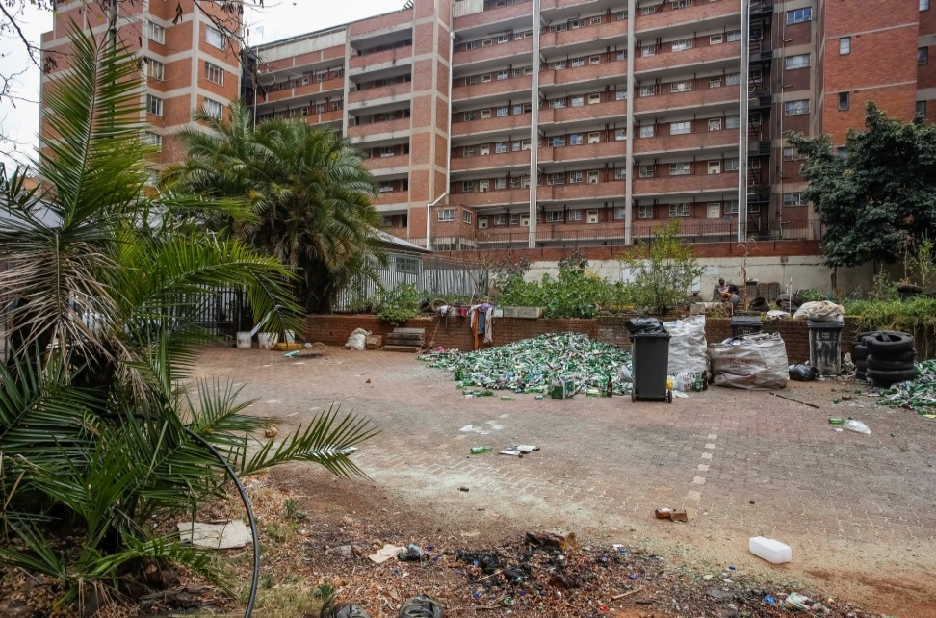
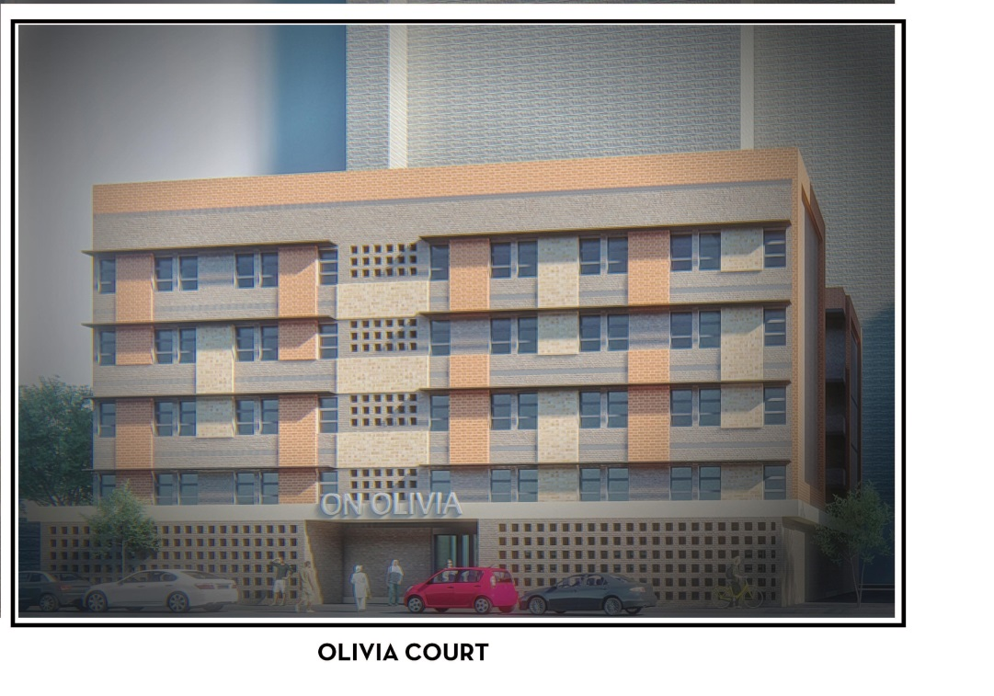
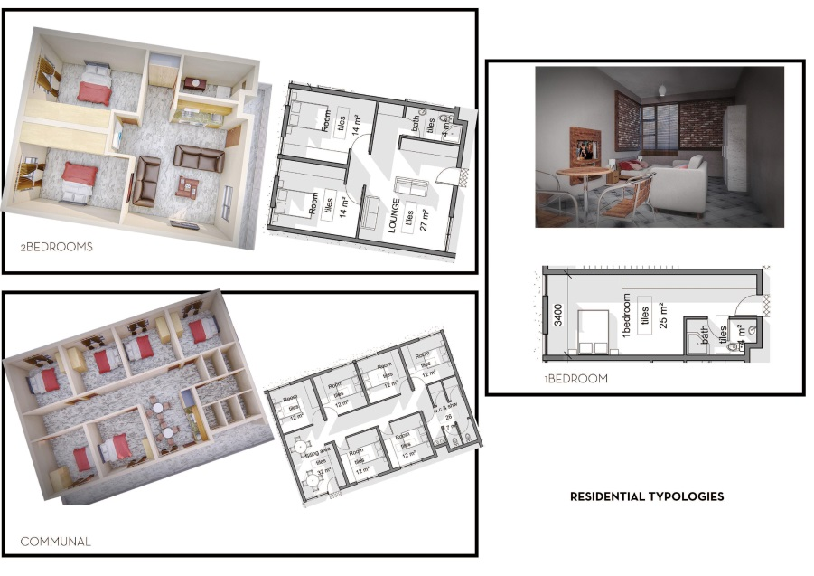
ERVEN 326 and 327 BEREA
(RFP 29/2018)
Before
After

Slide 6
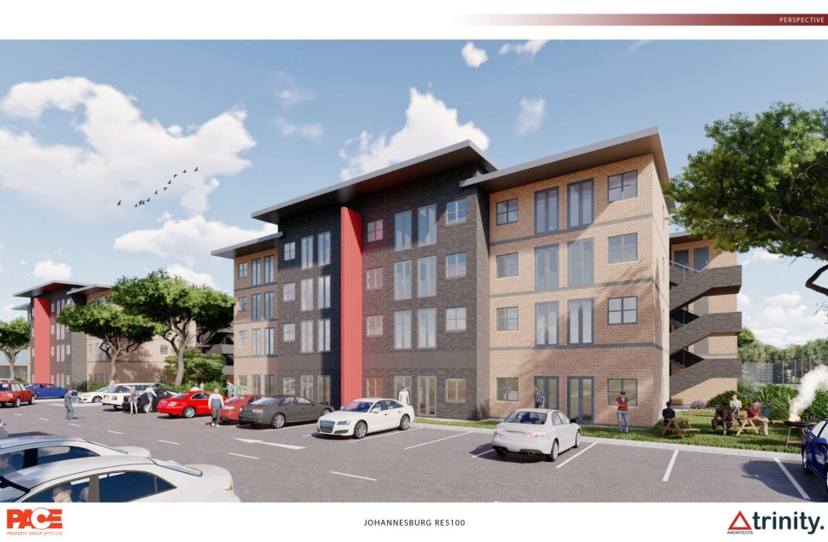
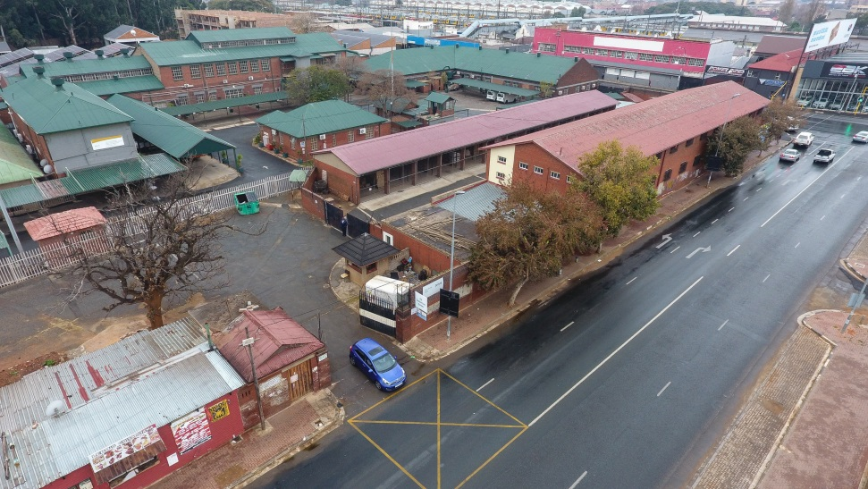
REMAINDER OF ERF 5100 JOHANNESBURG
(RFP 31/2018)
After
Before

Slide 7
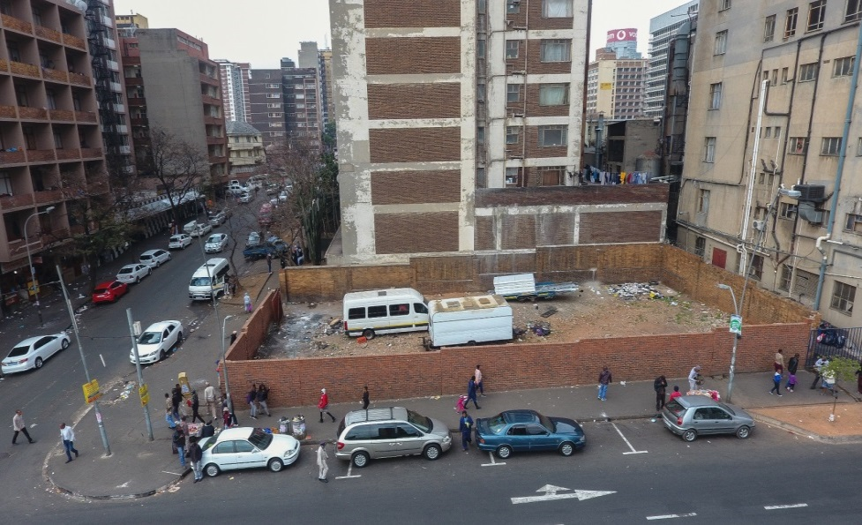
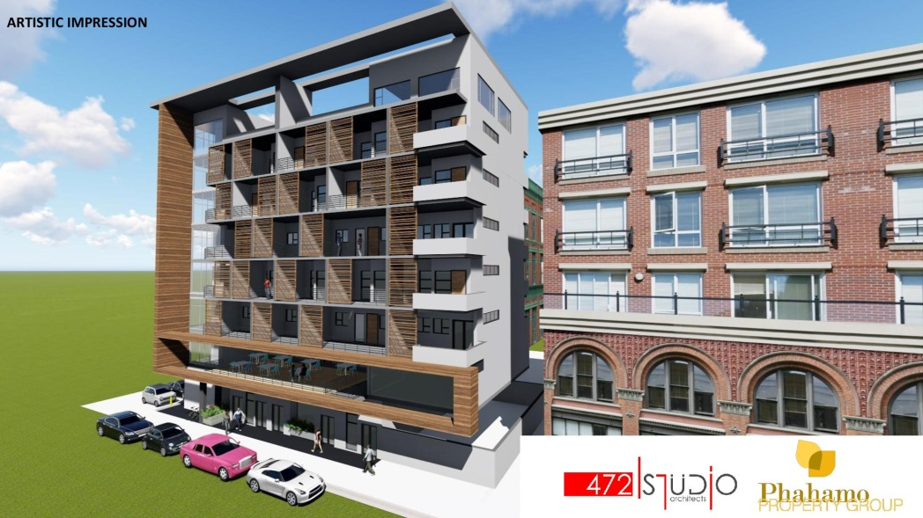
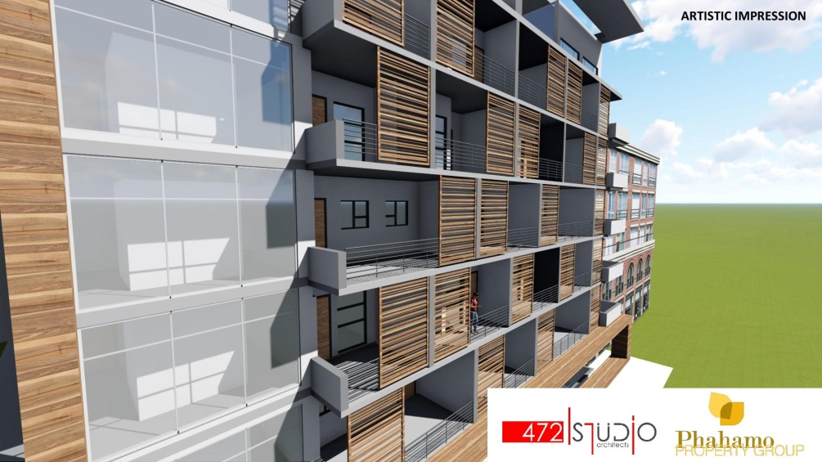
ERVEN 3807 and 3808 JOHANNESBURG (RFP 33/2018)
Before
After

Slide 8
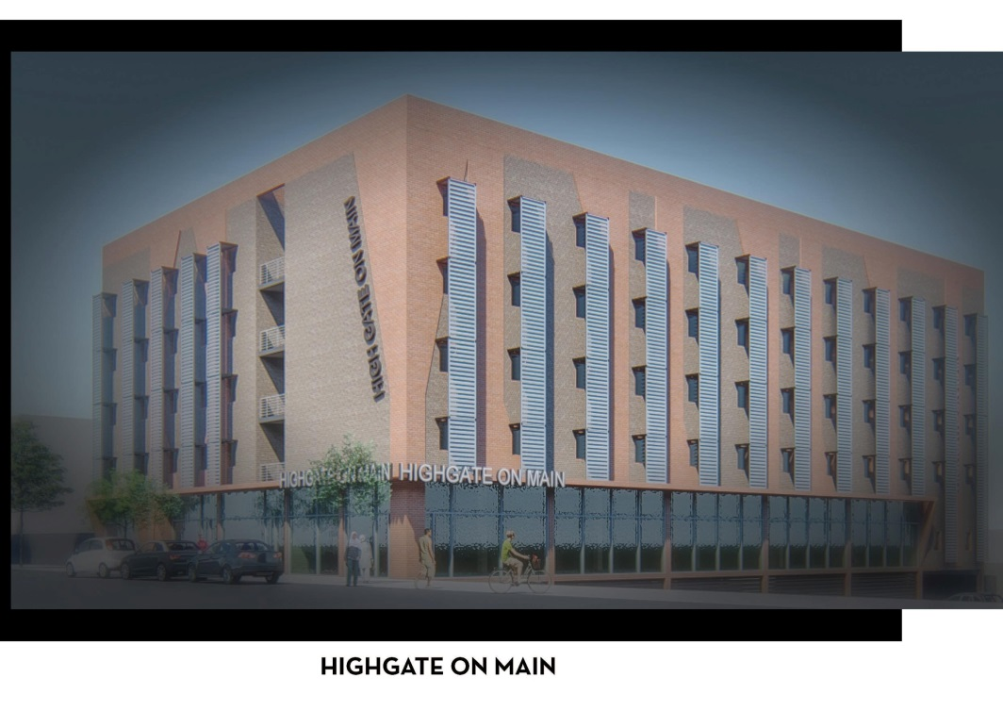
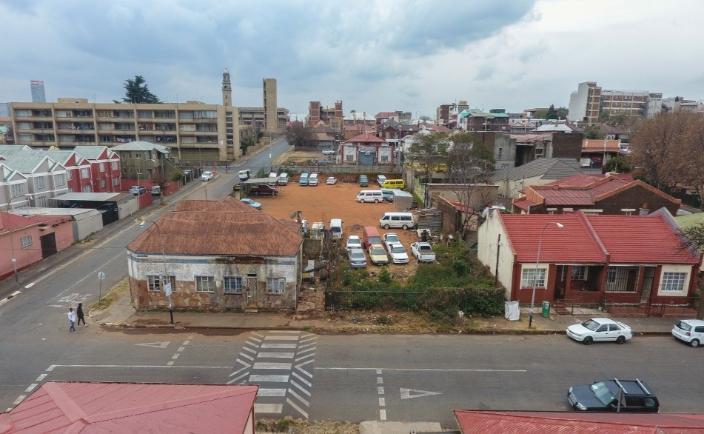
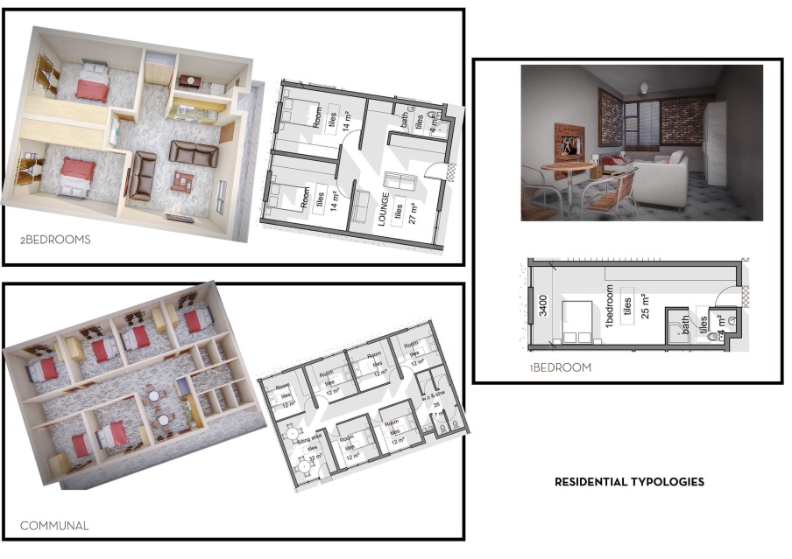
REMAINDER AND PORTION 1 OF ERF 2862 JEPPESTOWN (RFP 34/2018)
Before
After

Slide 9
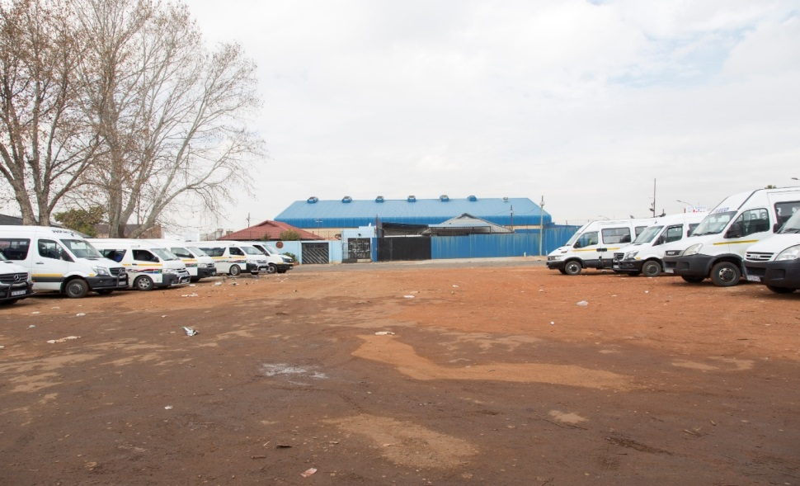
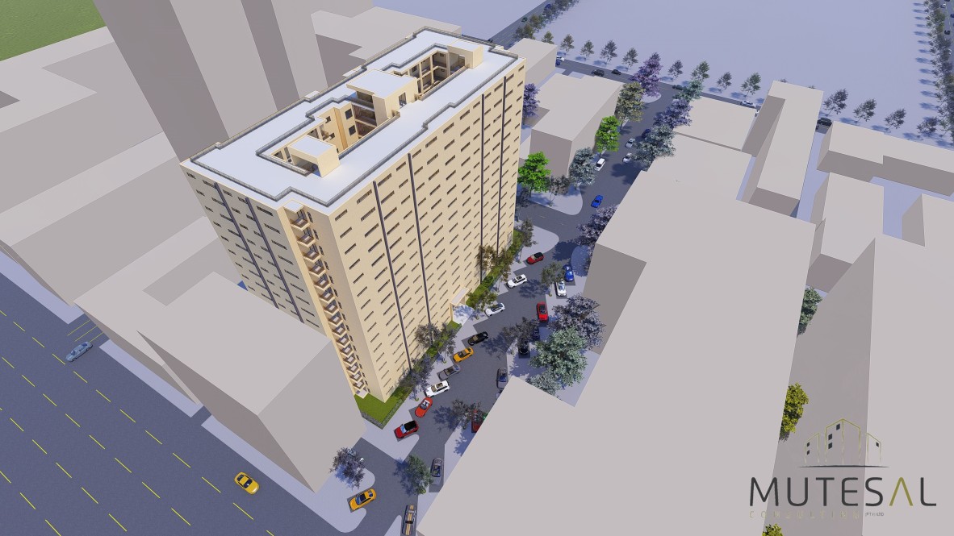
ERVEN 2146-2149 and 5075 JOHANNESBURG (RFP 35/2018)
Before
After

Slide 10
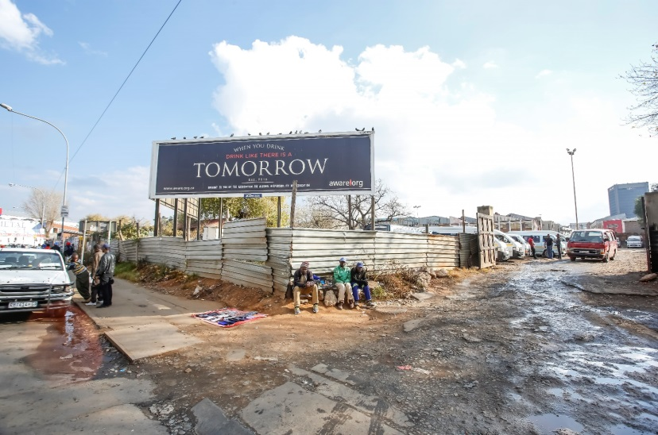
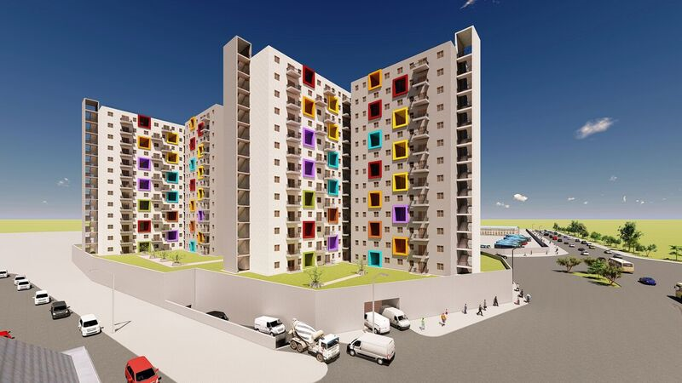
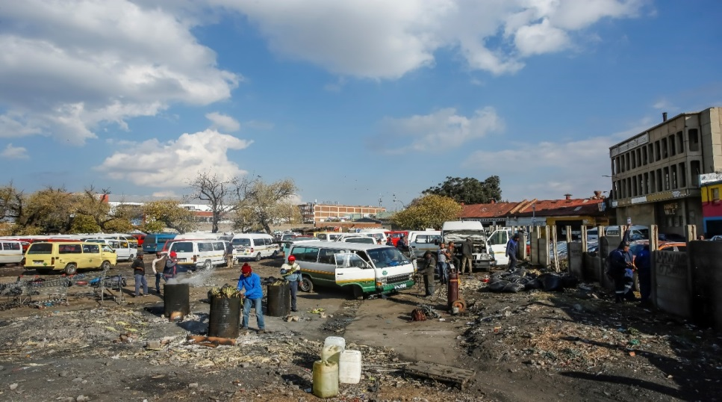
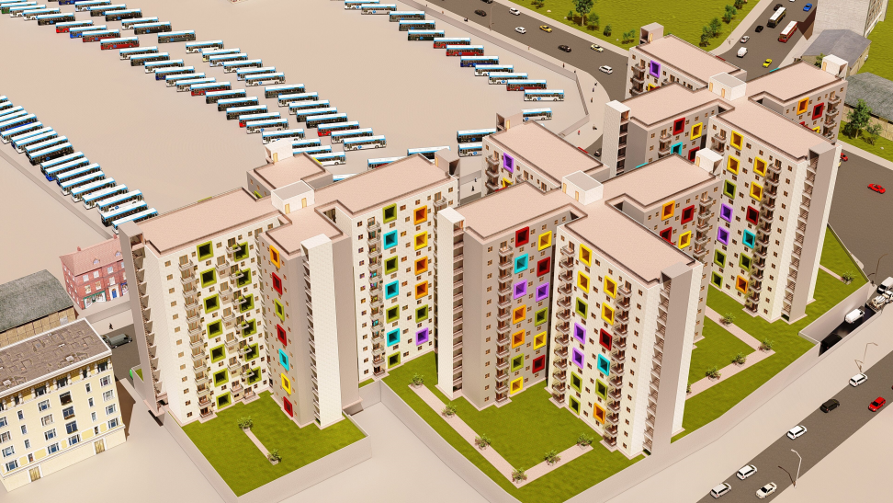
ERF 35 SALISBURY CLAIMS
(RFP 36/2018)
Before
After

Slide 11
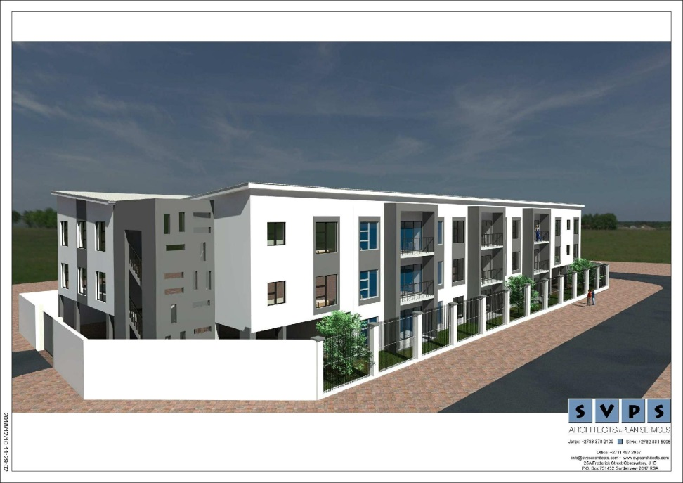
ERVEN 637 - 639 and 652 - 654 VREDEDORP (RFP 37/2018)
After
Before

Slide 12
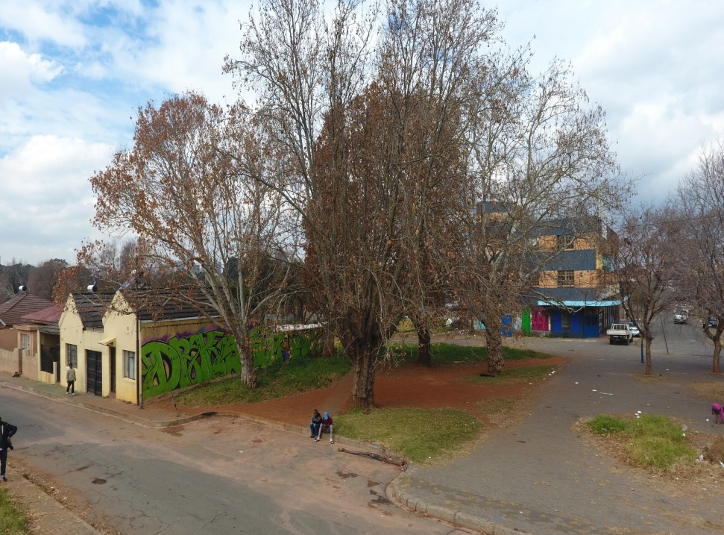
ERVEN 381, 396 - 399 and 401 VREDEDORP (RFP 42/2018)
After
Before

Slide 13
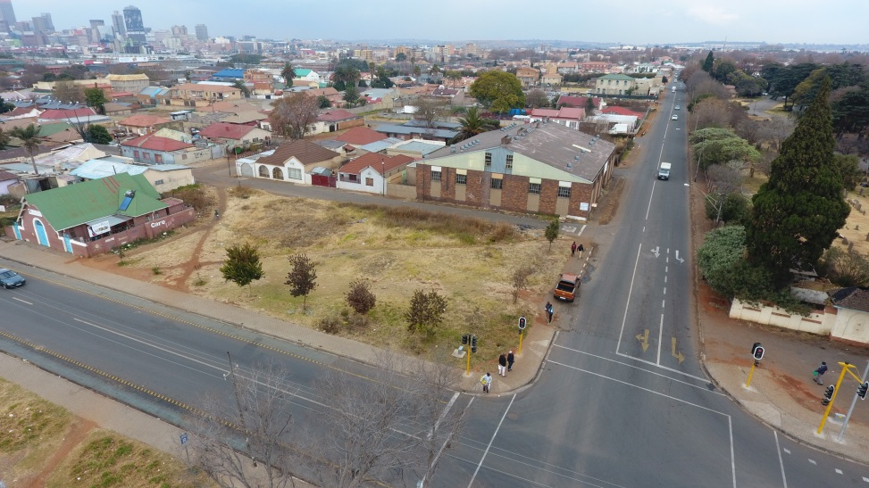
ERVEN 225 and 226 VREDEDORP (RFP 43/2018)
Before
After

Slide 14
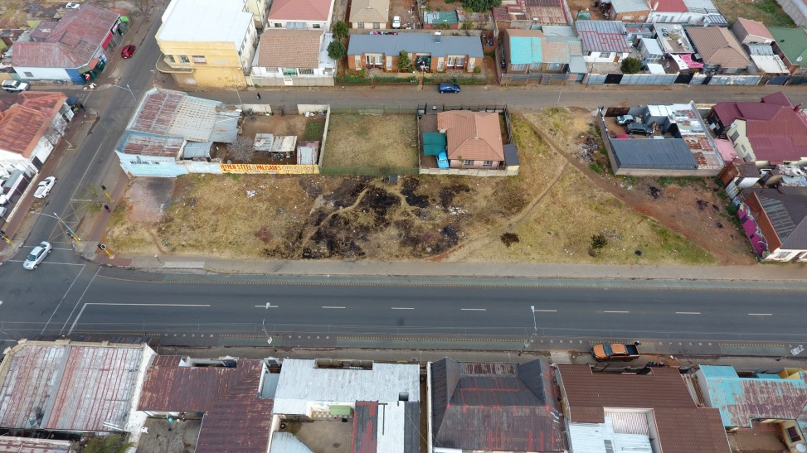
ERVEN 235 – 240 VREDEDORP (RFP 44/2018)
Before
After

Slide 15
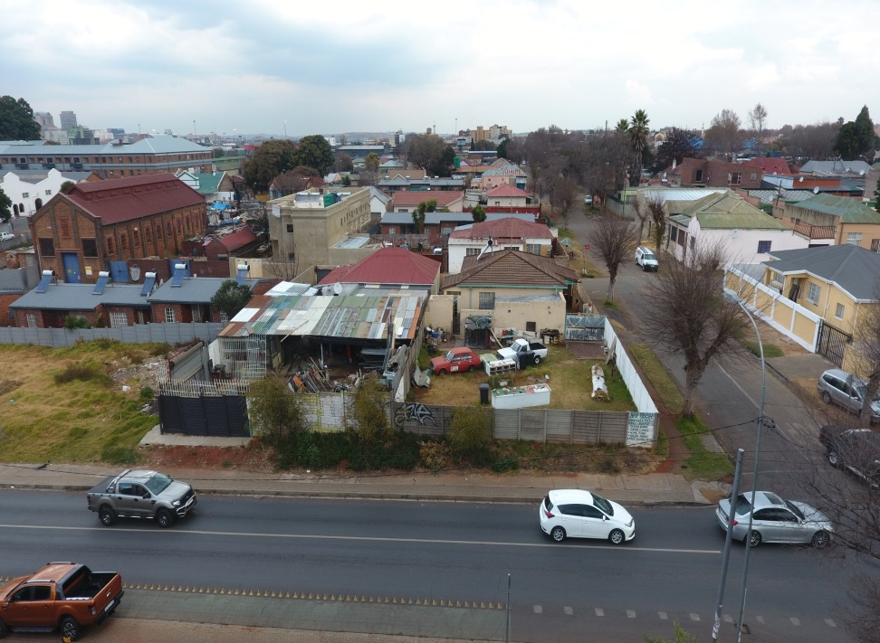
ERF 495 - 501 and 516 VREDEDORP (RFP 46/2018)
Before
After

Slide 16
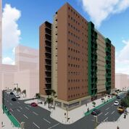
ERVEN 3545, 3546, 3547, 3548, 3549, 3550 and 3551 JOHANNESBURG
(RFP 47/2018)
After
Before

Slide 17
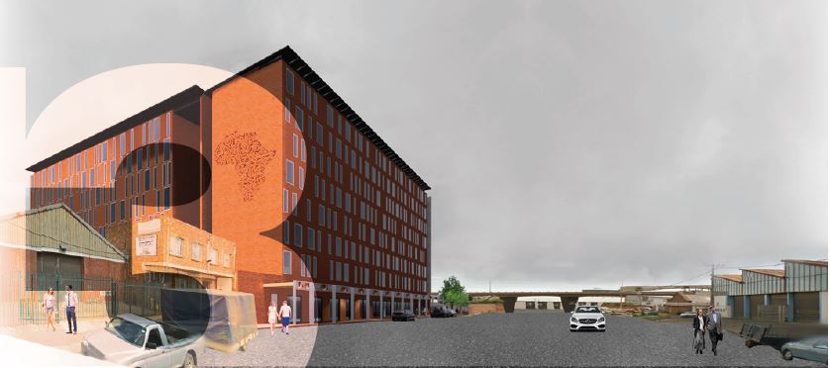
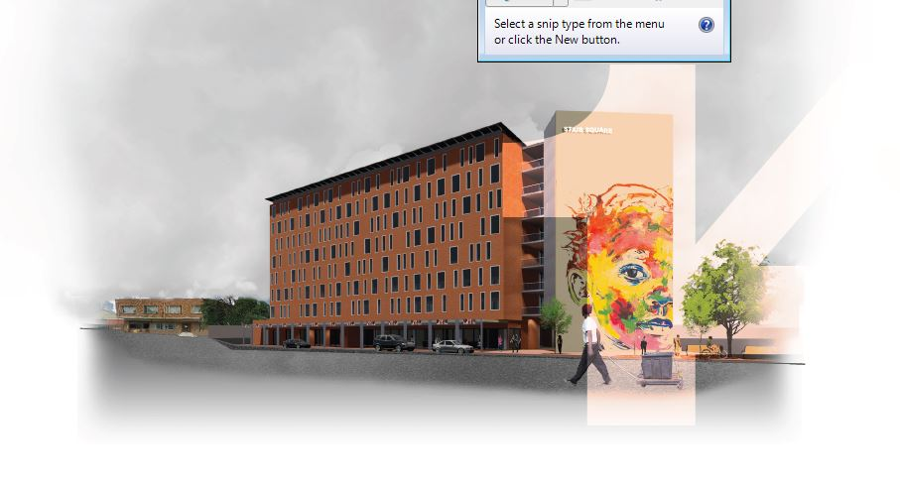
RE/260 DOORNFONTEIN 92-IR
(RFP 48/2018)
Before
After

Slide 18
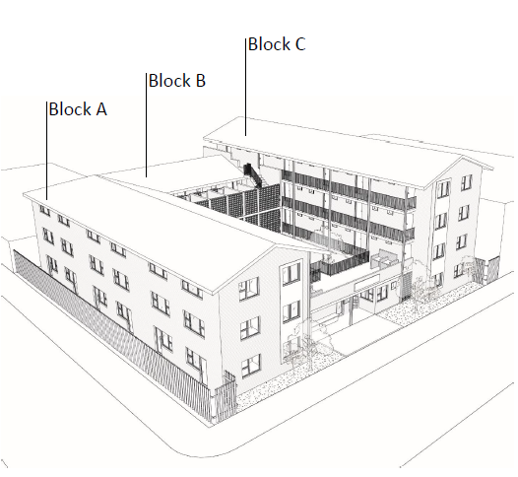
ERVEN 76, 79, 80
WOLHUTER (RFP 50/2018)
Before
After

Slide 19
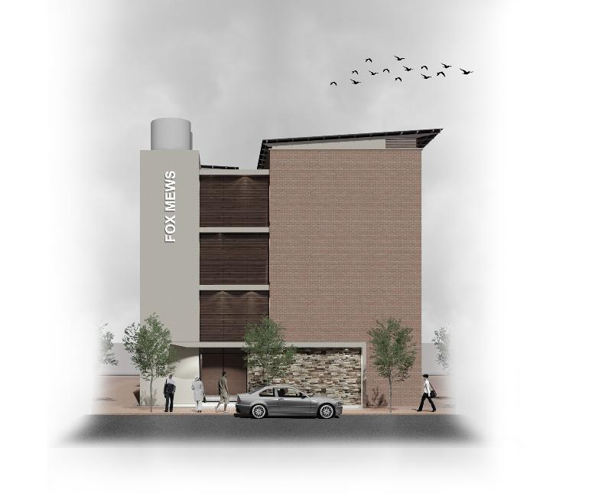
ERVEN 105, 106, 109, 110, 111, 112 FAIRVIEW
(RFP 51/2018)
After
Before

Slide 20

ERVEN 149, 153, 155, 157, 158, 159 FAIRVIEW
                (RFP 52/2018)
After
Before

Slide 21
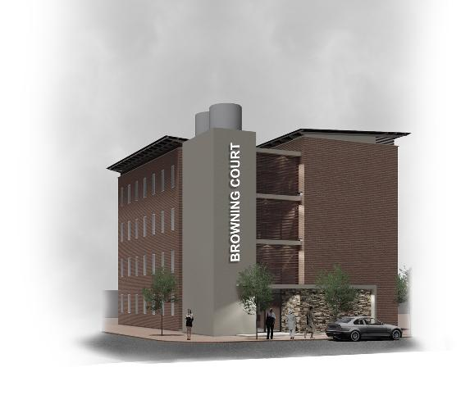
ERVEN 139, 140, 142, 144, 147 FAIRVIEW
(RFP 53/2018)
After
Before

Slide 22
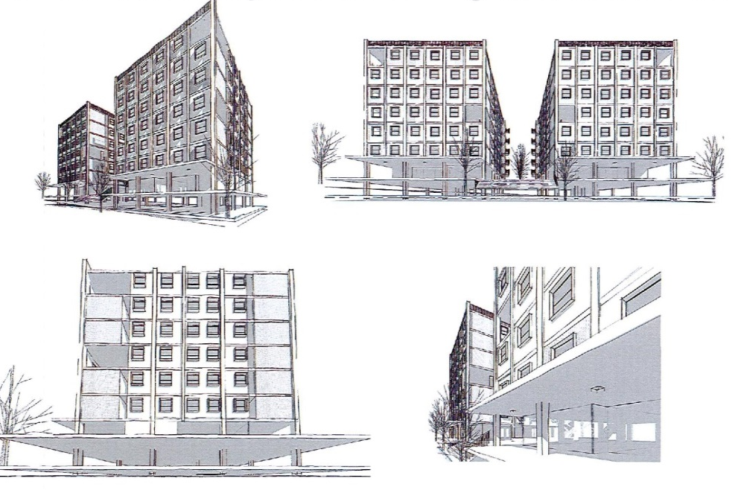
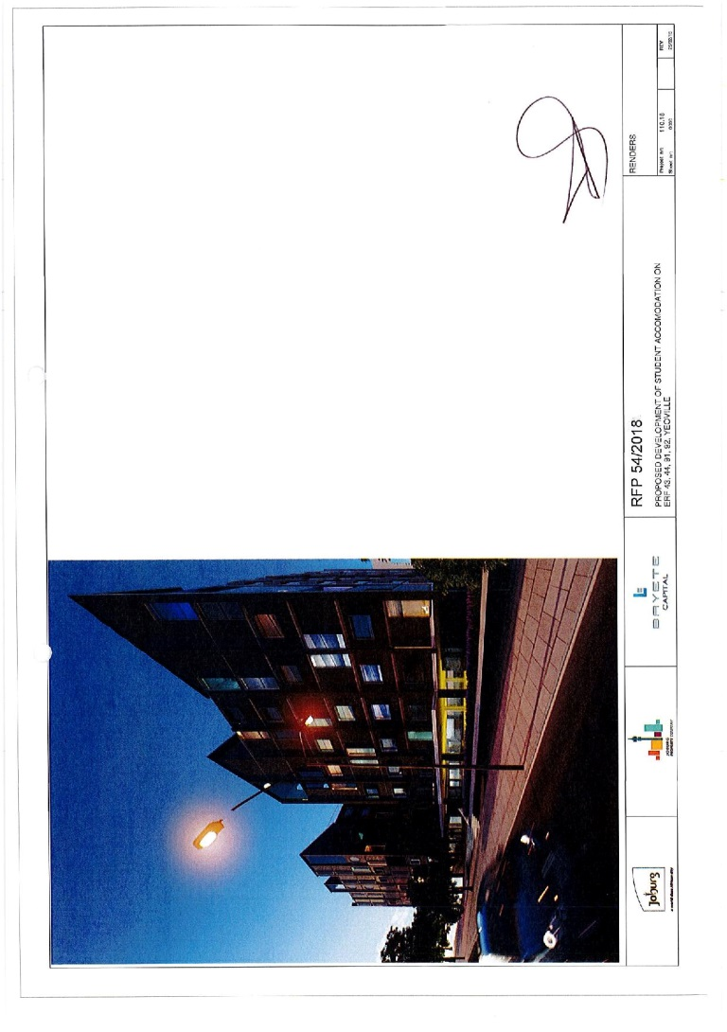
ERVEN 43, 44, 91, 92 YEOVILLE
(RFP 54/2018)
After
Before

Slide 23
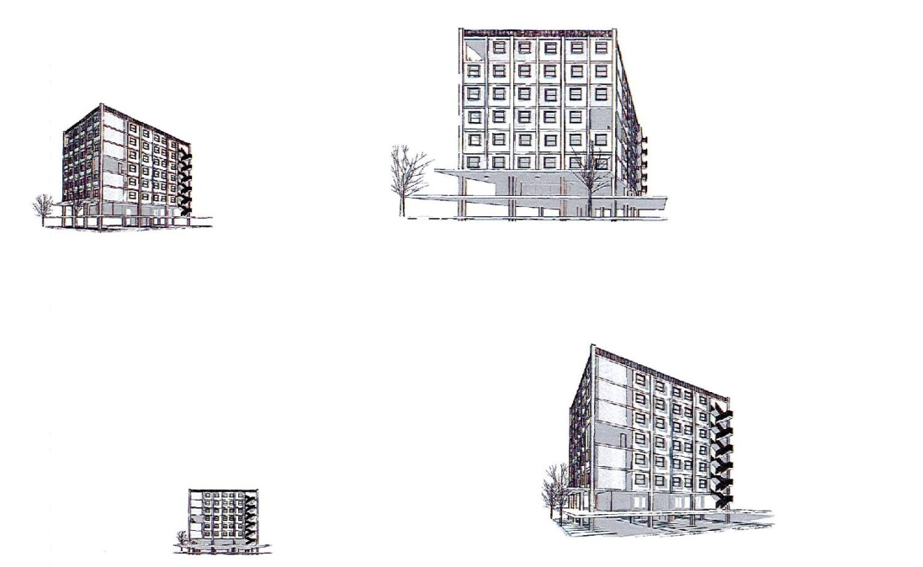
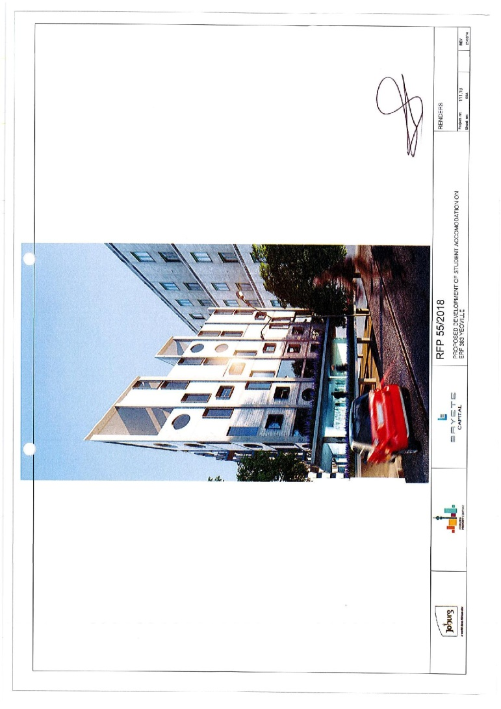
ERF 383 YEOVILLE
(RFP 55/2018)
Before
After

Slide 24
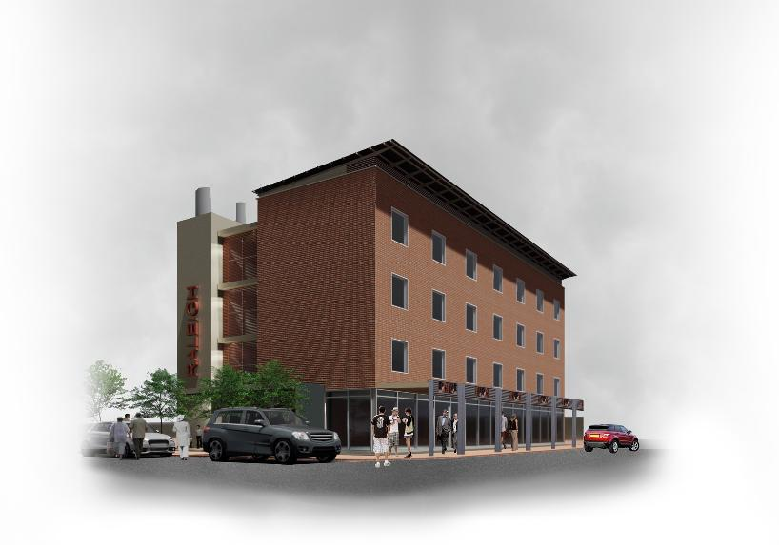
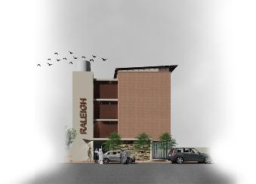
ERF 658 YEOVILLE
(RFP 56/2018)
Before
After

Slide 25
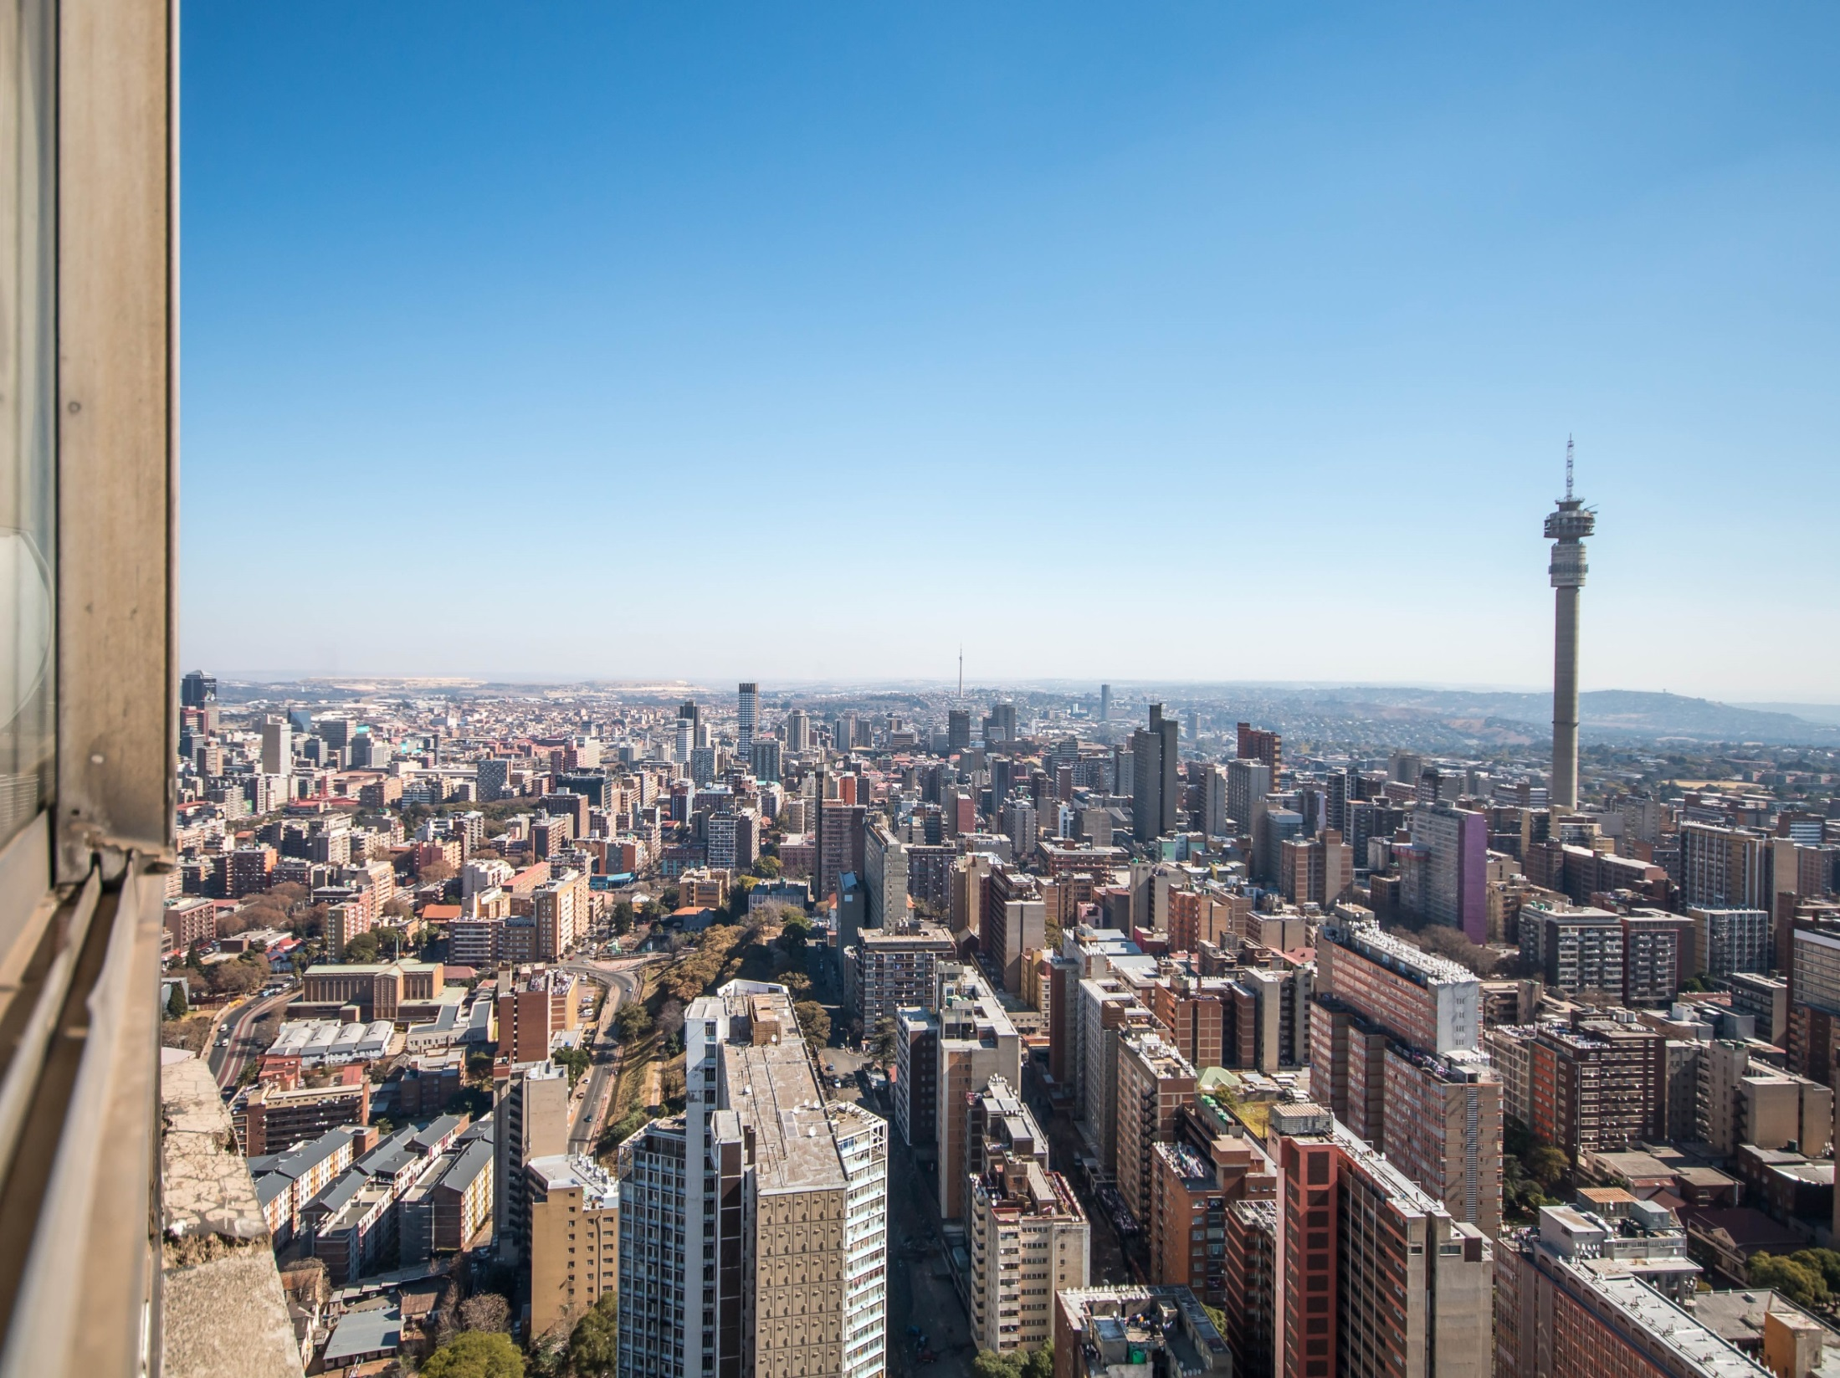
#BuildingNewJozi

