Slide 1

Soweto Gateway
Portion 159 of the Farm Diepkloof 319 IQ
RFP 33/2023 FY/PF
DOCUMENT AVAILABLE FROM: 2 JUNE 2023
CLOSING DATE: 7 JULY 2023
NON-COMPULSORY BRIEFING SESSION – 12 JUNE 2023
REQUEST FOR PROPOSALS FOR THE DEVELOPMENT SALE AND/OR LONG TERM LEASE OF PORTION 159 OF THE FARM DIEPKLOOF 319 IQ

Slide 2


Aerial map

Slide 3

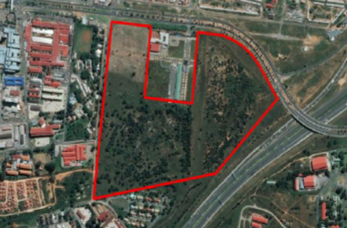
INTRODUCTION
LOCATION | The site lies in the far eastern part of Soweto , It Region D It is along a main entry into Soweto. West of the site is the Chris Hani Baragwanath Hospital. It is situated along the N1 with great visibility. Hot spot for high value infrastructure development The Bara Taxi Rank is 500m away.
EXTENT | 30.5 ha
DEVELOPMENT OBJECTIVES | Mixed use, accommodating a mix of land uses that will reinforce surrounding uses and activities. A well- balanced and sustainable urban structure that is connected and accessible to the rest of Soweto and the City. It is envisaged that it will be an iconic entrance point into Soweto. A place to Live, Work and Play.
DEVELOPMENT YIELDS | The housing yield is around 3366 housing units. Other uses include businesses, retail, high profile light industrial and training facilities, hotel/conference, community facilities, public open spaces, public roads.

Slide 4

Soweto empowerment zone (sez)
CURRENT STATUS SEZ | Occupies about 5ha within the site. Established in 2006 as a support facility for small businesses in Soweto Developed to grow local enterprise in the area. To be integrated into the greater development as one of 2 access points into the development. Other will be off Collinder Street. Was developed and managed by Department of Economic Development. Successful bidder to engage with JPC on integrating SEZ into the greater development.

Slide 5
Sez entrance

Slide 6
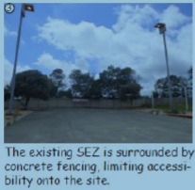
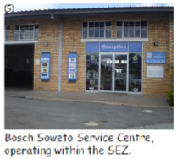
Sez- currently

Slide 7
Site is vacant

Slide 8
title deed restrictive conditions
Upgrading of the Elias Motswaledi Informal Settlement by developing low cost housing and related municipal infrastructure.
A 2m wide servitude in perpetuity over the property in favour of AECI Ltd for constructing a gas line.
Being Proclaimed Land – it is subject to the Provisions of the Gold Law. Crowne Mines has the right to minerals and mining on the site. So gold mining operations are permitted underground.

Slide 9
APPOINTMENT OF TURNKEY
DEVELOPMENT FACILITATOR
Turning Point Project Managers – appointed end 2018.
Appointed to do the following:
Formulate a Property Plan
To conduct detailed investigations/ studies of the site
Submission of the Town Planning application/rezoning/ proclamation and approval of the mixed use township – process is underway
All studies and investigations conducted made available on JPCs website on a link

Slide 10
studies conducted
Geotechnical Study
Heritage Study
Environmental Screening Report
Town Planning Report
Civil Engineering Assessment
Mixed Market Study
Traffic Scoping Report
Land Survey Layout
Services Report
Basic Assessment Report
Urban Design Report with a Property Plan

Slide 11
findings from the various studies
TOWN PLANNING:
Site is currently zoned mining.
Rights applied for – a mixture of land uses
Site size = 30,5ha.
Part of the property to be used for low cost housing – must be adhered to.
City Council will support a mixed- use development with minimum residential densities of 50 dwellings units per hectare.
LAND SURVEY:
Land Surveyor’s map revealed 3 servitudes on site:
A 2m wide gas line on the eastern boundary of the site.
A 20 m wide public road reserve along the western boundary
A 32 meter wide pipeline servitude close to the centre of the site .
There are also unprotected services on site which are not within a registered servitude.

Slide 12
findings from the various studies
GEOTECHNICAL :
The site is underlain by topsoil, hillwash and fill overlying the residual sandstone and sandstone bedrock.
The in-situ materials are of a suitable quality for site road layer works and construction.
Overall, the site is developable.
ENVIRONMENTAL:
The site is situated far from wetland and rivers and falls outside the 1:100 year floodline.
The proposed development will not trigger a water use licence application process.
The most common vegetation type on the site is thatching grass and khaki weed.
The site does not fall within any identified Critical Biodiversity Areas.
The site is developable.

Slide 13
findings from the various studies
HERITAGE REPORT:
There are no visible restrictions or negative impacts in terms of heritage associated with the site.
In terms of heritage this project can proceed.
It should be noted that the sub-surface archaeological and/or historical deposits and graves are always a possibility. Care should be taken during any work in the entire area.
ELECTRICAL SERVICES:
The Orlando Substation which is the closest to the site, requires upgrading in order to enable additional power for any new developments in the area – has capacity of 30MVA but is fully utilized
Proposed development needs 15MVA power
Mondeo Substation has available capacity, however will be a challenge bringing this across the M1 freeway
Nancefield Substation also has capacity but it is 10 km away

Slide 14
findings from the various studies
CIVIL ENGINEERING :
Water:
The site is serviced by the Diepkloof Reservoir- has adequate capacity to supply the estimated demand for the proposed development.
Connection to the bulk supply line will be done upon capacity approval from JW.
Water connections can be made along Chris Hani Road as well as on the site.
Sewer:
There is a sewer collector pipe running on the perimeter of the site with possible connection points.

Slide 15
DEVELOPMENT OBJECTIVES
PROPERTY VISION
To accommodate a mix of land uses taking advantage of the location of the site entrance into Soweto/ Baralink Node etc.
To reinforce surrounding uses and activities such as: institutional, educational, local manufacturing, training facilities, commercial etc.
To be supported by medium to high density mixed income residential, community facilities, recreation and public spaces within a well balanced and sustainable urban structure.
Well connected and accessible to the rest of Soweto and the City.
An iconic entrance point into Soweto
A place to Live – Work - play

Slide 16
PROPOSED TOWNSHIP MIX
Residential component - medium to high density mixed income residential, social housing for the rental market, low cost housing
Business – shops, restaurants, offices, car sales, motor / other showrooms, warehouses
Retail
High profile light industrial and training facilities
Hotel / Conference Centre
Community facilities - educational, child care centres, clinic & medical consulting rooms, social halls, sports and recreation clubs
Public open spaces
Public roads

Slide 17
Proposed Development concept

Slide 18
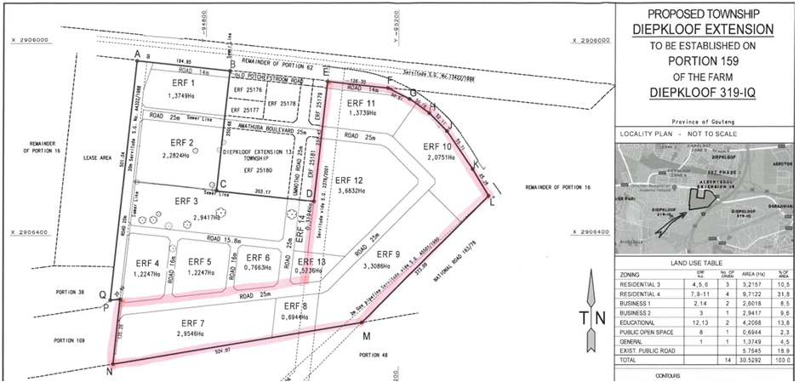
Proposed township

Slide 19
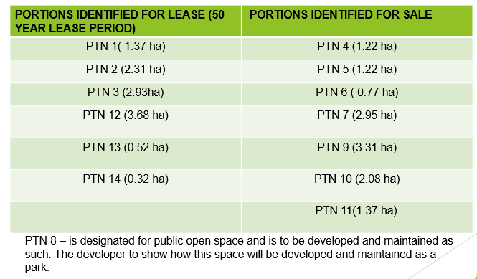
Portions for sale & lease

Slide 20
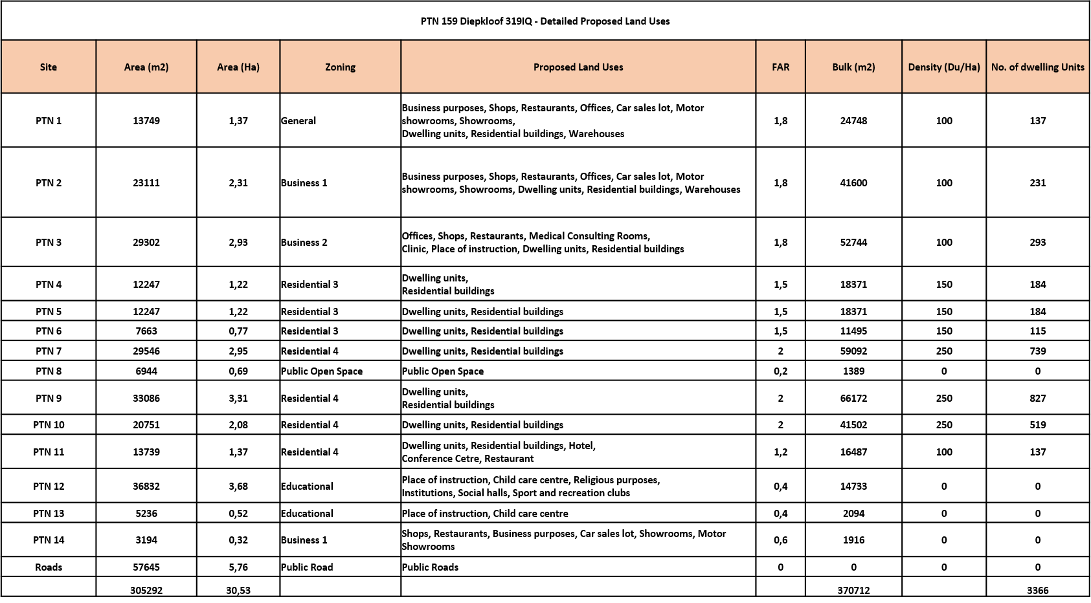
Detailed proposed land uses

Slide 21
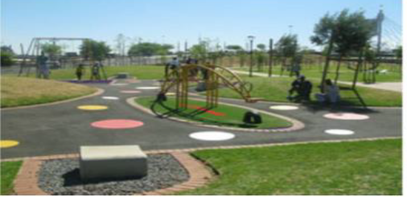
Possible Look and feel – some images

Slide 22


